Slide 1
Introduction To Machine Learning
Goldsmiths University
PCA and LDA

Slide 2

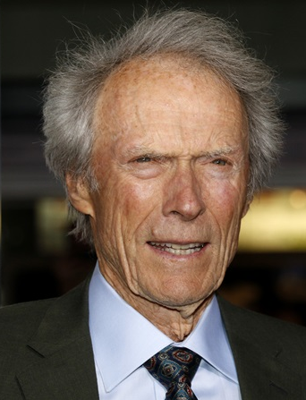
PCA - Principal Component Analysis
How can we differentiate these two people?
possible attributes:
height, weight,
age,
salary,
hair color..
Select one component (adult/child) and this component represents all the other attributes such as age, salary, hair color...
Child
Adult

Slide 3

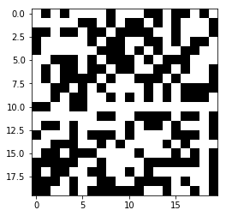
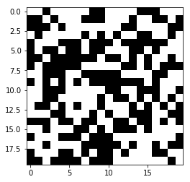
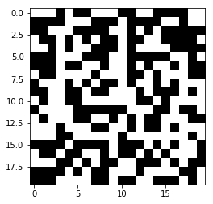
The space (list of attributes and values) can be very big
I want to generate the number 6 in a 20 by 20 pixels square.
I generate random values (0 or 1) in a 20 by 20 pixels square. The space to investigate is huge is 2^400.

Slide 4
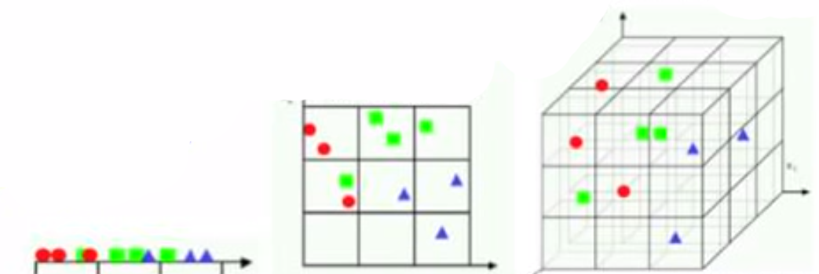
Huge space is not good for Machine Learning.
Statistics need repetition (fill the space of probability of the classes (RF ,NB..) :
You flip a coin once you get head. Is the probability of p(head) = 100%?
More empty regions with more features. Less statistical repetition. More data needed to learn a good model

Slide 5
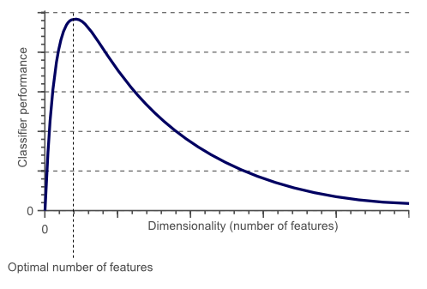
Another trade-off
When the dimensional space (how many features - how many columns) becomes higher than an optimal number of features the performance of a Machine Learning model starts to decrease.

Slide 6
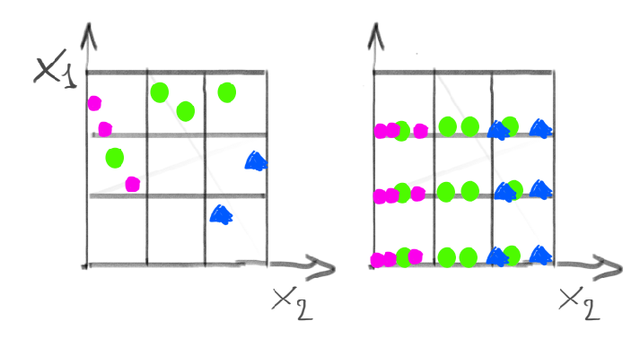
Solutions : assume independence
We can assume independence like naive bayes.
e.g. Modelling green given x1 and x2, would require us to collect many samples
Instead we might count along each dimension separately.

Slide 7

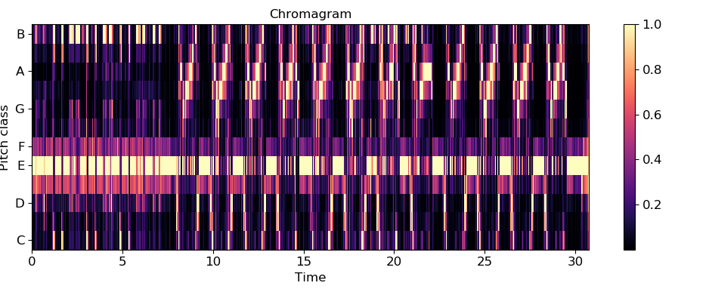
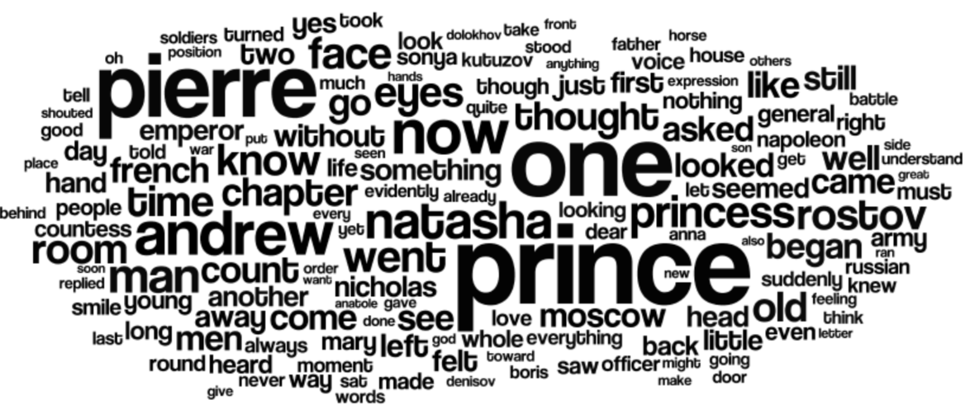
Solution: Use domain knowledge
Feature extraction using OpenCv.
Here for instance we can extract a defined number of “very important” (surf) features from an image. (ig 50 features against width*length of images features)
Feature extraction for sound (a good python tool is Librosa).
Stop word for text or other techniques NLP. (Python NLTK or spaCy, Gensim, Pattern....)

Slide 8
Dimensionality reduction with...
Or we can reduce dimensionality with:
Feature selection - use the most useful features (using Information gain (DT)
Feature engineering - create a function that maps some features to a single one (e.g., multiplication)
Principal Components Analysis

Slide 9
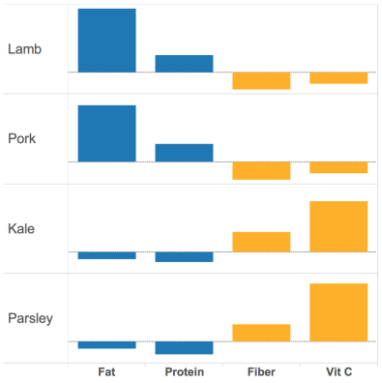
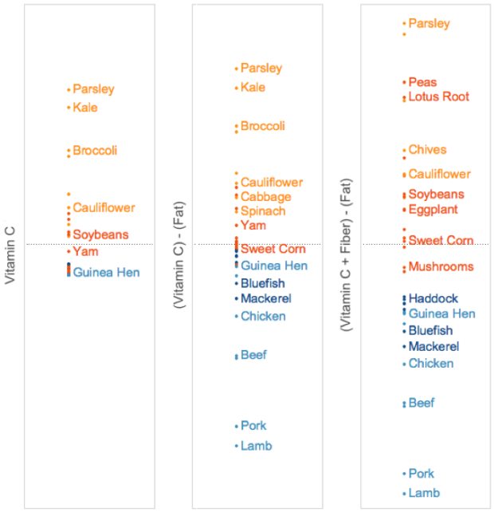
Maximising the variance
We have a dataset of food with the following features (F=4)
Vitamin C
Fat
Protein
Fiber
Notes:
From https://algobeans.com/
Limitations of maximising spread approach – pancake

Slide 10
Maximising the variance
We have a dataset of food with the following features (F=4)
Vitamin C
Fat
Protein
Fiber
Make a new feature: VitaminC - Fat
(taking care to normalise the values to make the comparable)
The data spreads out more
Notes:
From https://algobeans.com/
Limitations of maximising spread approach – pancake

Slide 11
Maximising the variance
We have a dataset of food with the following features (F=4)
Vitamin C
Fat
Protein
Fiber
Make a new feature: VitaminC - Fat
(taking care to normalise the values to make the comparable)
The data spreads out more
Now sum VitaminC – Fat + Fiber
Even better spread
These are linear combinations of the original feature space
Notes:
From https://algobeans.com/
Limitations of maximising spread approach – pancake

Slide 12
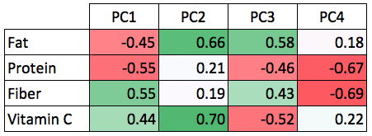
Principle components and food
Covariance in features
We can see correlations in co-occurrence of some features
fat and protein ‘move together’
protein and fiber ‘move apart’
Idea:
instead of using all 4 features, combine those that are correlated
This is the basis of PCA
Create new features based on linear combination of the old ones (principle components)
Use weights to indicate the importance of each feature’s contribution:

Slide 13
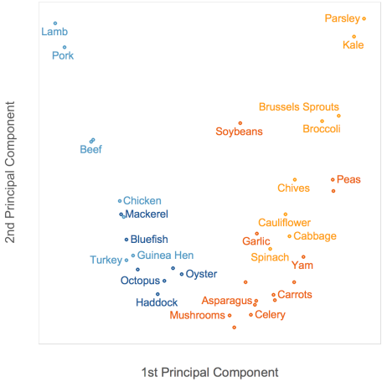
PCA and food
Using our top 2 principle components, we can visualise the data clearly
Calculation:
PC1 = 0.55*fiber + 0.44*VitC
- 0.55*protein – 0.45*fat
PC2 = 0.66*fat + 0.7*VitC
+ 0.21*protein +0.19*fiber
Notes:
From https://algobeans.com/
Limitations of maximising spread approach – pancake

Slide 14
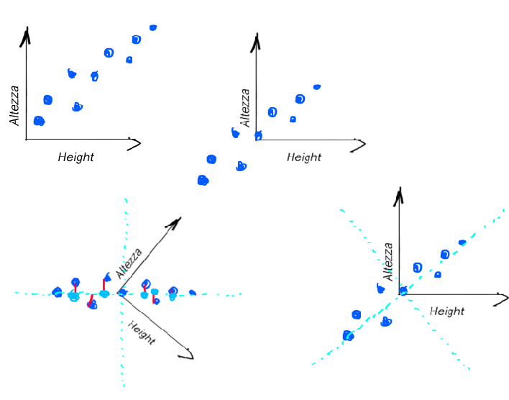
How it works
Scale the data using the mean and std.
Do some algebra to find the axis that represents the higher variance of the data.
Project the data into that axis. And therefore reduce the dimension.

Slide 15

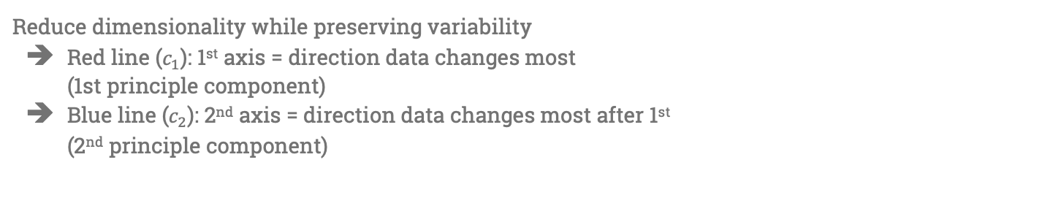





PCA
Reduce dimensionality while preserving variability
Red line ($c_{1}$): 1st axis = direction data changes most (1st principle component)
Blue line ($c_{2}$): 2nd axis = direction data changes most after 1st (2nd principle component)
$$c_{1}$$
$$x_{2}$$
$$c_{2}$$
3D
2D
1D
$$x_{3}$$
$$c_{1}$$
$$x_{1}$$

Slide 16
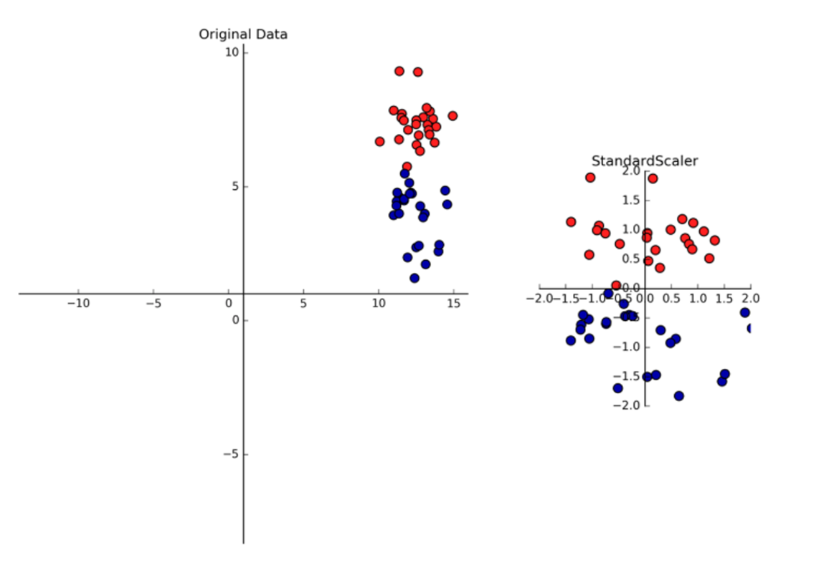
Standard Scaler
To find that axis PCA calculates the covariance, which is extremely sensitive to large values. So if one column has high values it will become the principal component. It will dominate over all the other features no matter what. (and you might not want it)
So we need to normalise each dimension to zero mean unit variance x = (x - mean) / std

Slide 17
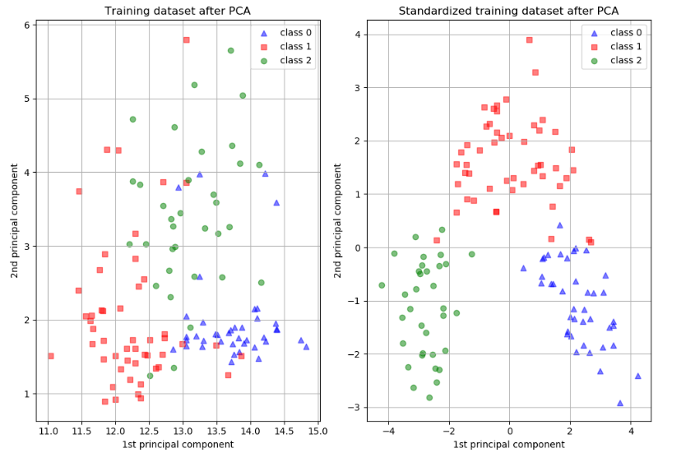
Effect after PCA with not normalised and normalised data
No feature scaling
Yes feature scaling

Slide 18
Issues
PCA with classification can mess things up for the Machine learning model
This would be better
This is the PCA’s axis

Slide 19
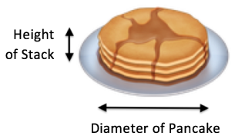
limitations: The pancake problem
Maximising variance isn’t always what we need
* If we are interested in the number of pancakes, then height is a more useful dimension than diameter
* But PCA will select diameter if it has more variance (i.e. for a small number of pancakes)

Slide 20
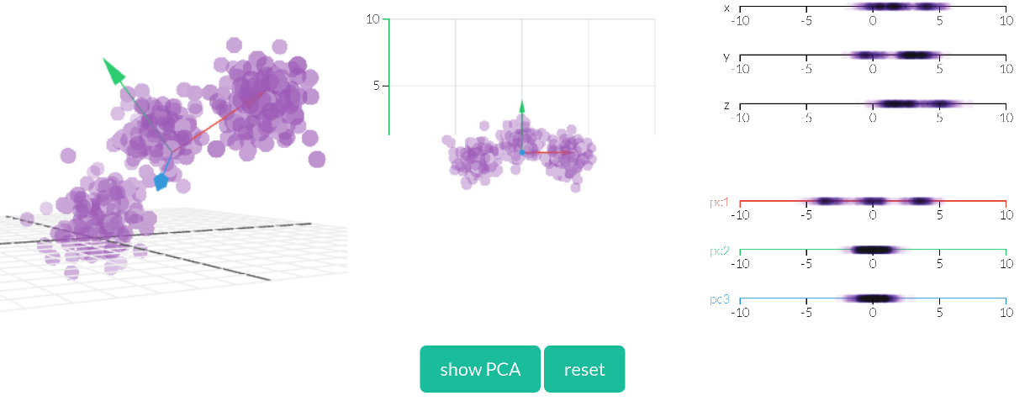
Visualisations
Some nice interactive examples:
http://setosa.io/ev/principal-component-analysis/

Slide 21
Extra

Slide 22
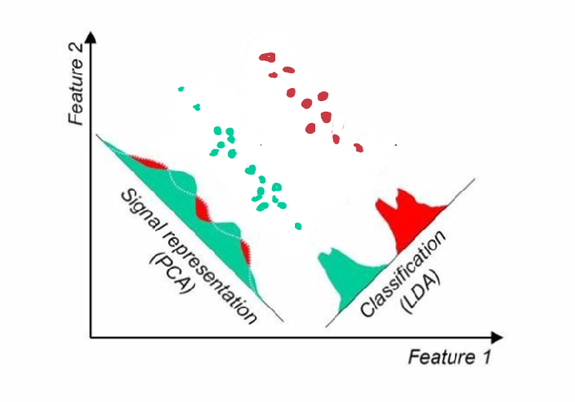
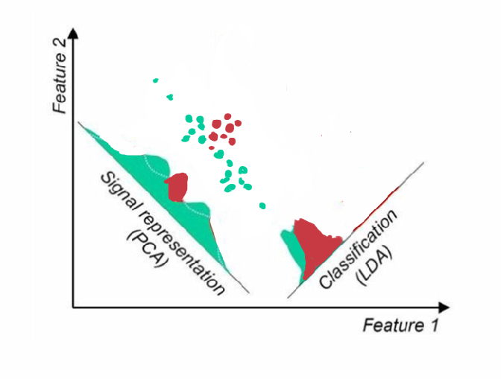
LDA
Linear discriminant Analysis - maximum separation between means of projected classes and maximum variance within each projected classes.
But this does not mean that LDA always works better (right .. a non linear ML can perform better if uses data created with PCA rather than LDA)

Slide 23
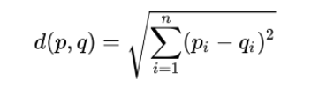
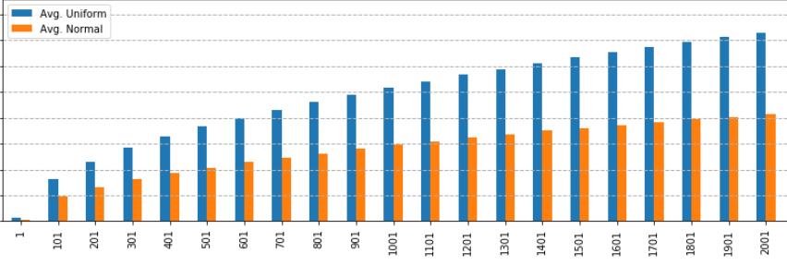
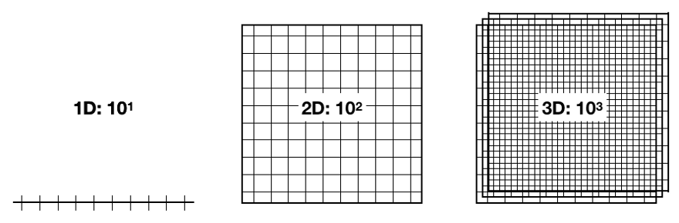
Curse of Dimensionality: another issue - distances (distance based ML)
Each new dimension ( i ) adds a term to the formula. The distance increases with the number of dimensions: as the number of features grows for a given number of observations, the feature space becomes increasingly sparse; that is, less dense, or emptier.
When the distance between observations grows, supervised machine learning becomes more difficult because predictions for new samples are less likely to be based on learning from similar training features. The number of possible unique rows grows exponentially as the number of features increases, which makes it so much harder to efficiently generalize. The variance increases as they get more opportunity to overfit to noise in more dimensions, resulting in poor generalization performance.
To keep same dist we needed 10^3 in 3D

Slide 25






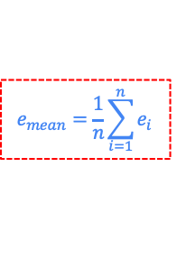


Extra: (n-fold) Cross Validation
Fold 1
Fold 2
Fold 3
Fold 4
Data
Train
$${\text{Test}}_{4}$$
$${\text{Test}}_{3}$$
$${\text{Test}}_{2}$$
$${\text{Test}}_{1}$$
$$ε_{1}$$
$$ε_{2}$$
$$ε_{3}$$
$$ε_{4}$$
$$e_{mean}=\frac{1}{n}\sum_{i=1}^{n}{e_{i}}$$

Slide 26








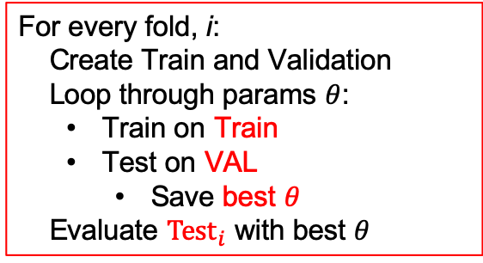

Extra: (n-fold) Nested Cross Validation
How to pick the best from a set of parameters?
e.g., $θ$={ k={1,2,3,4,5}, distance={Euclidean, Manhattan} }
For every fold, i:
Create Train and Validation
Loop through params $θ$:
Train on Train
Test on VAL
Save best $θ$
Evaluate ${\text{Test}}_{i}$ with best $θ$
Fold i
Inner loop
$$k=1$$
D = Eucl.
$$k=2$$
D = Eucl.
$$…$$
$$k=5$$
D = Man.
Data
Train
Train
Train
Train
$$…$$
test
test
test
VAL
VAL
VAL
Within each CV fold, split training data into training and validation sub-sets to tune hyperparameters.
$${\text{Test}}_{i}$$
best $θ$
$$\{2,Eucl\}$$
$$ε_{i}$$

